Slide 1

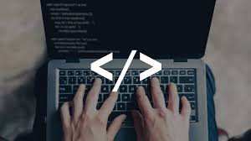
Seminar -1
(Presentation)
Native Language Learner
Name :Prathamesh Vivek Bhagat
Roll No:32
PRN No:2046491245032
Branch: Computer Engineering

Slide 2



Slide 3



Slide 6

Introduction
But still this Technological advancement is far from the reach of poor citzens of India.
Technology is advancing very fast these days and Comuters play a very crutial role in this advancement.
The Goal of our project is to bring this technological advancement to reach of the weaker sections of society .

Slide 7

We know that learning a programming language is not an easy even for a well off person with low technical back ground.
The project idea is to create a programming language in a native /local language which would provide ease to the poor citizens/weak learners to learn about computes and bring the technological advancement in their reach. The goal is also to create a website which teaches them a programming language in a very understandable way

Slide 8


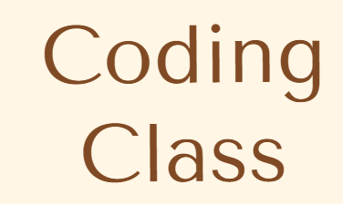

अगर (3>2)
तो लिखो “yes”
:- if(3>2)
print yes

Slide 9

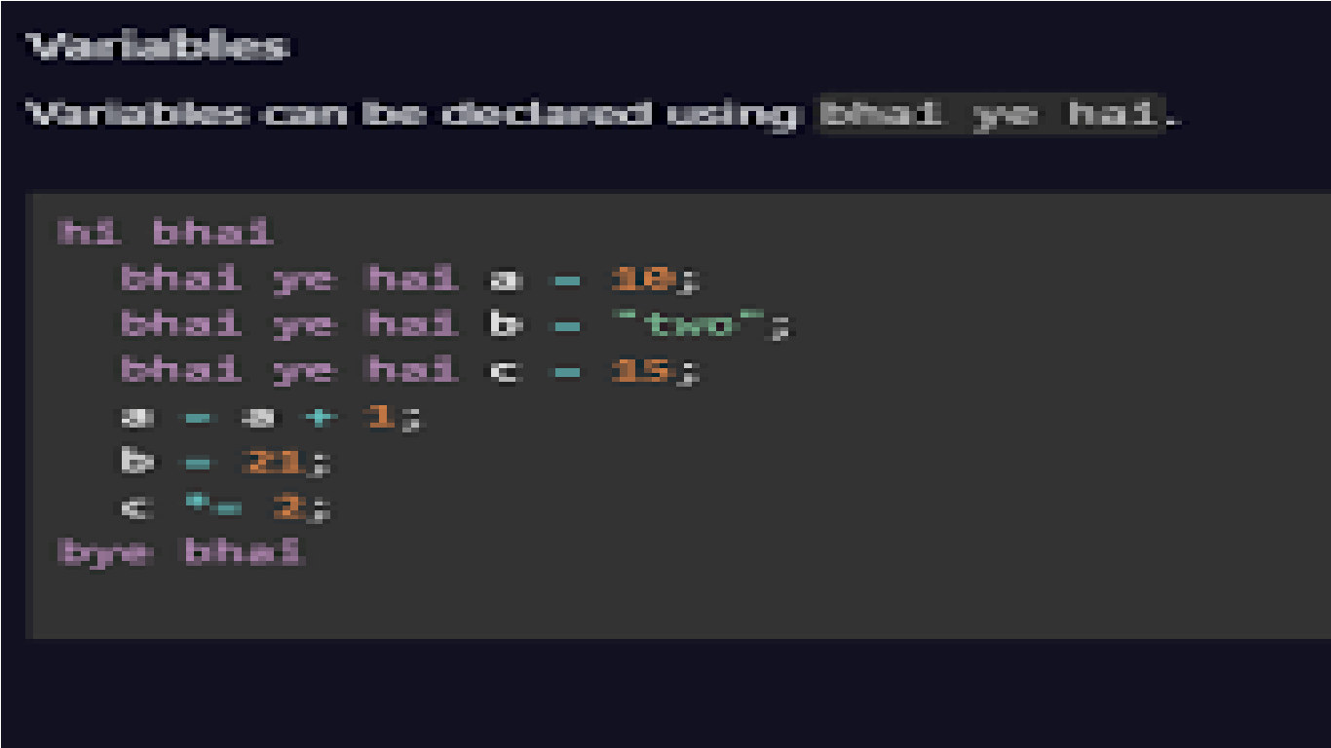
An attempt was made to create a new programming language by two youngsters of India who created “BHAI-LANG” to give a tribute to their favourite movie star Mr. Rajnikant .
A similar attempt would be made to create a programming language which would be in local language with all the high end features and would be easy to learn. And the web site would teach netizens to use the language easily .

Slide 10

The site would have all the nessary information about the use of the language in a very simple way . And would introduce all its modules / classes in local language

Slide 11

Thank You

